Slide 1
FITNESS PLANNER
Need Finding and lofi prototype

Slide 2
Insights
How can we make fitness as a daily routine
How can ensure users workout with healthy competition
To have Self workout enthusiasm.

Slide 3
Fitness is essential for everyone.
Daily Workout factors:
Time
Diet
Motivation to do regularly
Motivation to burn more calories
Social encouragement

Slide 4
Why workout ? : Physical activity or exercise can improve your health and reduce the risk of developing several diseases like type 2 diabetes, cancer and cardiovascular disease. Physical activity and exercise can have immediate and long-term health benefits. Most importantly, regular activity can improve your quality of life.
Motivation to workout consistently: competitive spirit is the practice of self improvement. It is the basic unit of life for an individual who wants it all and is willing to do the work to get itcompeting with friends ensures good consistency.

Slide 5
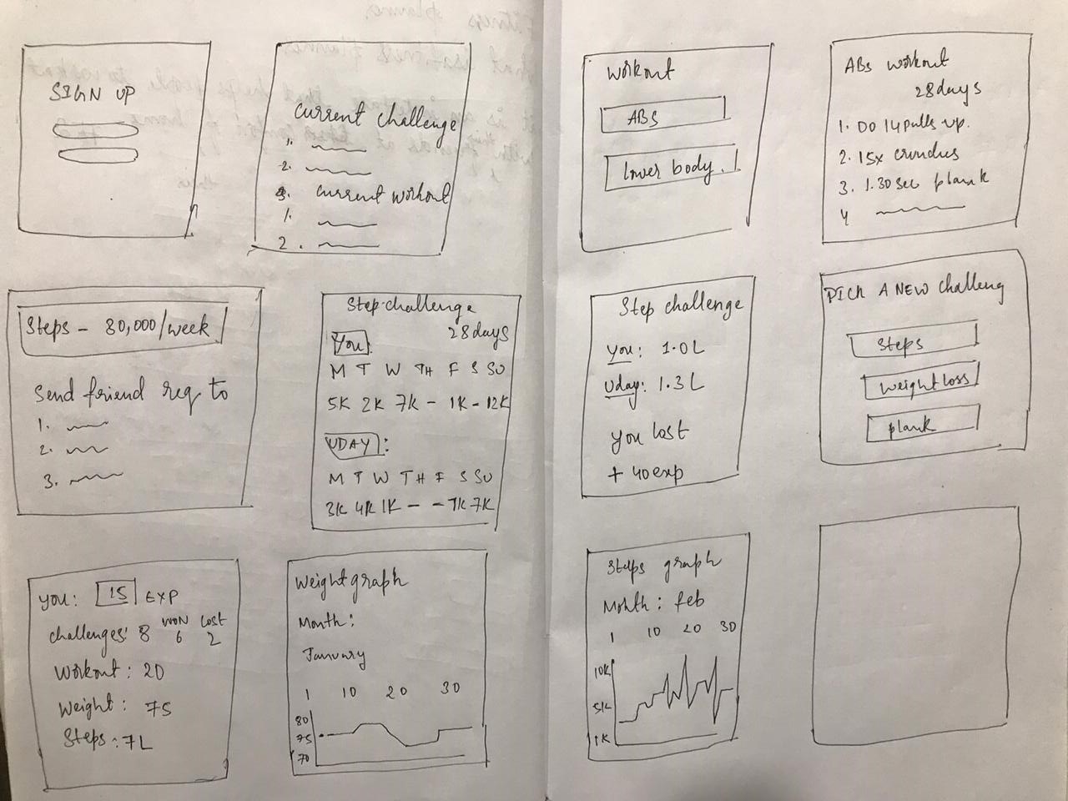
Lofi Prototype

Slide 6
Concept video:
https://youtu.be/nFw1zJov8cY

